Slide 1



Research proposal
https://gradcoach.com/wp-content/uploads/what-is-a-research-proposal.png
Prof. Darya Alontseva
School of IT and IS
D. Serikbayev East-Kazakhstan Technical University (EKTU),
Ust-Kamenogorsk (Oskemen), dalontseva@ektu.kz, dalontseva@mail.ru

Slide 2

Content
What is a Research Proposal? Key points
What is a dissertation (or thesis) research proposal?
Structure of an Academic Research Proposal. Key points
Format of a research proposal
Learning outcomes
References
https://upload.wikimedia.org/wikipedia/commons/thumb/d/d9/Humanit%C3%A9s_Num%C3%A9riques.JPG/1024px-Humanit%C3%A9s_Num%C3%A9riques.JPG

Slide 3



What is a Research Proposal?
A research proposal is a document proposing a research project, generally in the sciences or academia, and generally constitutes a request for sponsorship of that research [1] .
Proposals are evaluated on the cost and potential impact of the proposed research, and on the soundness of the proposed plan for carrying it out[2]

Slide 4
Research proposals generally address several key points:[3]
What research question(s) will be addressed, and how they will be addressed
How much time and expense will be required for the research
What prior research has been done on the topic
How the results of the research will be evaluated
How the research will benefit the sponsoring organization and other parties

Slide 5
What is a dissertation (or thesis) research proposal?
A research proposal is a structured, formal document that explains what you plan to research (i.e. your research topic), why it’s worth researching (i.e. your justification), and how you plan to investigate it (i.e. your practical approach) [4]
The purpose of the research proposal is to convince your research supervisor, committee or university that your research is suitable (for the requirements of the degree program) and manageable (given the time and resource constraints you will face).
Academic research proposals are generally written as part of the initial requirements of writing a thesis, research paper, or dissertation [5]
They generally follow the same format as a research paper, with
an introduction,
a literature review,
a discussion of research methodology and goals,
a conclusion

Slide 6

To sum up
https://gradcoach.com/wp-content/uploads/research-proposal-definition.png

Slide 7
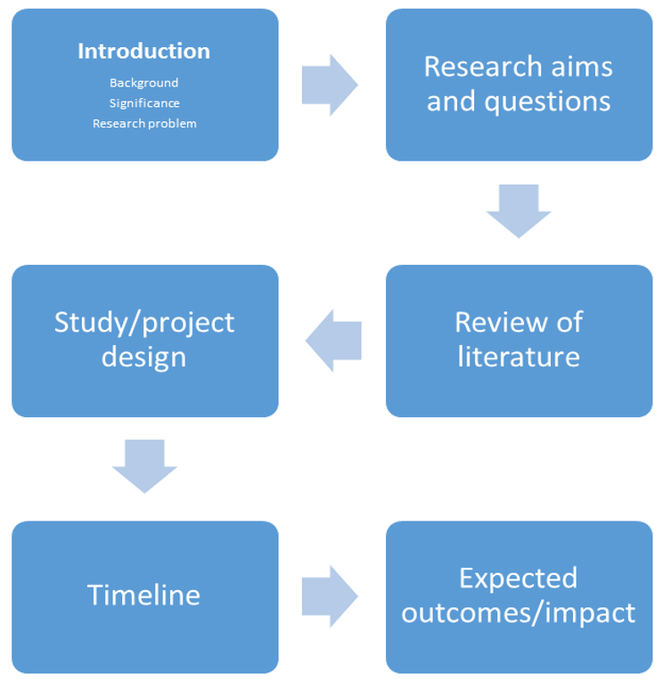


Structure of a Research Proposal

Slide 8
Key points
Background: you have to introduce the research topic to your reader and explain why it is significant.
Focus here on the dominant trends and more recent developments in this field.
Why is this topic significant to you? Why should others be interested in it?
What is a good research question?
A good research question should be:
Relevant: It must clearly relate to the problems or issues that the project seeks to address.
Important: It should address a key problem in the field
Clear: It should be expressed using concise language and contain no ambiguity.
Precise: What is being investigated should be clearly specified.
Researchable: The information and sources required to answer the question must exist and you must be able to access them.
Explain the design of your project in a clear and logical way.

Slide 9
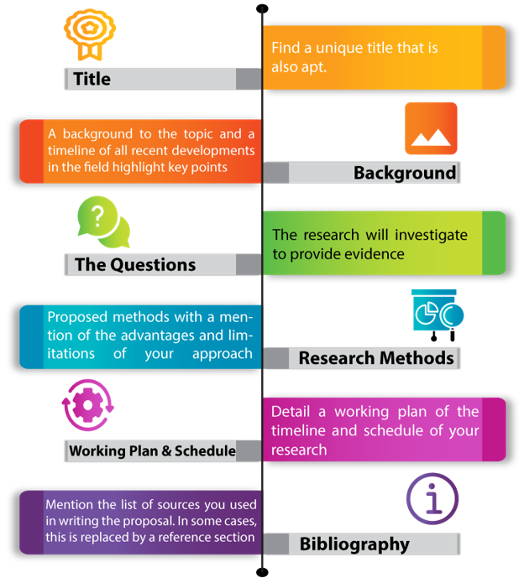

Slide 10

Learning Outcomes
you are able to identify the genre of the research proposal
you are able to explain the purpose and structure of the research proposal

Slide 11
References:
"Research proposal". BusinessDictionary.com. Retrieved 21 June 2016
Wong, Paul T. P. "How to Write a Research Proposal". International Network on Personal Meaning. Retrieved 21 June 2016.
Yousaf, Saeed T. P. "Keypoints of a Research Proposal". Scholarshipfellow.com. Retrieved 7 January 2018.
What (Exactly) Is A Research Proposal? A Plain-Language Definition & Explanation (With Examples) By: Derek Jansen (MBA) | June 2020 https://gradcoach.com/what-is-a-research-proposal-dissertation-thesis/
"How to Write Academic Research Proposal". A Jonson Hillviews Magazine Editor. Retrieved 20 December 2018.
"Writing a Research Proposal". University of Illinois at Urbana-Champaign. Retrieved 21 June 2016.
https://www.questionpro.com/blog/what-is-research/
https://en.wikipedia.org/wiki/Research_proposal
https://www.ahrq.gov/funding/process/grant-app-basics/esstplan.html
https://www.slideshare.net/mehwishshahid73/research-plan-31631062
Reference:

Slide 12


